Slide 1
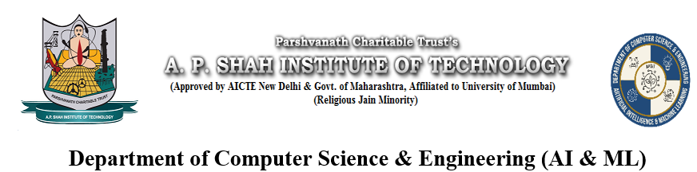
SURPLUS SERVE - Bridging Feast to Need
Parth Rane – 23106018 Yash Sawant – 23106009
Sohan Vernekar – 23106012
Project Guide
Ms. Yogehswari Hardas
2024-25
Notes:
1

Slide 2
Introduction
In India and many other countries, massive quantities of food are wasted every day, especially during social events like weddings, corporate functions, festivals, and parties. At the same time, millions of people go hungry, and many NGOs are actively trying to feed the underprivileged but there’s a disconnect between surplus food and those who need it. Event organizers often throw away leftover food due to lack of immediate access to NGOs or distribution channels. NGOs rely on manual or informal communication, which is slow, inefficient, and unscalable. There is no standard platform that bridges this gap in real time with trust and efficiency.
Notes:
2

Slide 3
Literature Survey of the Existing System
App/System
Robin Hood Army
Feeding India (Zomato)
Roti Bank
App/System | Country | Target Users | Working Mechanism | Limitations | Reference
Robin Hood Army | India, Pakistan | Volunteers, NGOs | Volunteers collect excess food from restaurants/events and distribute it manually to needy communities. | No centralized app, manual coordination, not real-time, no automated NGO matching. | RobinHoodArmy.com
Feeding India (Zomato) | India | Restaurants, NGOs | Partners with restaurants to donate surplus food via verified NGO network. | Limited to urban areas, depends on restaurant willingness, no live-event food rescue feature. | Zomato Foundation
Roti Bank | India | Individuals, Communities | Manual collection and distribution through community volunteers. | No technology platform, lacks scalability and instant coordination. | rotibank.org
Notes:
3

Slide 4
OLIO
Too Good To Go
ShareTheMeal
Replate
Food Rescue US
UK, Global | Households, individuals | Allows neighbors to share food via listings; focuses on reducing domestic waste. | No NGO connection, not event-focused, more peer-to-peer sharing. | olioex.com
Europe, USA | Consumers, Restaurants | Sells surplus food at reduced prices before expiry. | Commercial app, not a donation model, doesn’t connect with NGOs. | toogoodtogo.com
Global (UN WFP) | Global Donors | Users donate money to feed children via UN WFP; not focused on food waste. | Not a food redistribution app, donation-based financial model. | sharethemeal.org
USA | Businesses, Corporates | Provides staff to pick up surplus food and deliver it to nonprofits. Offers analytics for food saved. | Only in specific US cities, no real-time matching, requires subscription for services. | replate.org
USA | Food Donors, Volunteers, Agencies | App-based system where volunteers pick up and drop food between donors and agencies. | Mostly regional, no India-focused implementation or NGO verification. | foodrescue.us

Slide 5
Problem Statement
"In India, a significant amount of surplus food from events such as weddings, parties, and corporate gatherings goes to waste due to the lack of a centralized, real-time platform that connects food donors with NGOs and charitable organizations. Existing systems are either manual, unstructured, or limited to commercial sources like restaurants.
Proposed Idea
Mobile app to bridge Event Organizers and NGOs
Real-time donation requests & acceptance
Navigation API→ live pickup location & navigation
Push Notifications → instant updates on food availability
Transparent and efficient food redistribution system
Monetary Donations will be an options for individuals and other organizations

Slide 6
Overview of System Design
User Registration:
Donors and NGOs register and are verified by the admin.
Donor Posts Surplus Food:
Event organizers upload details like food type, quantity, pickup address, and available time window.
NGO Matching & Notification:
System uses geolocation and availability status to notify nearby NGOs in real-time.
NGO Response:
NGOs can accept or reject the food request. First confirmed NGO is assigned the pickup.
Pickup & Confirmation:
NGO collects food and confirms receipt via app. Donor is notified, and status is updated in the database.
Admin Monitoring:
Admin monitors all transactions, verifies NGO activities, and handles exceptions.
Notes:
6

Slide 7
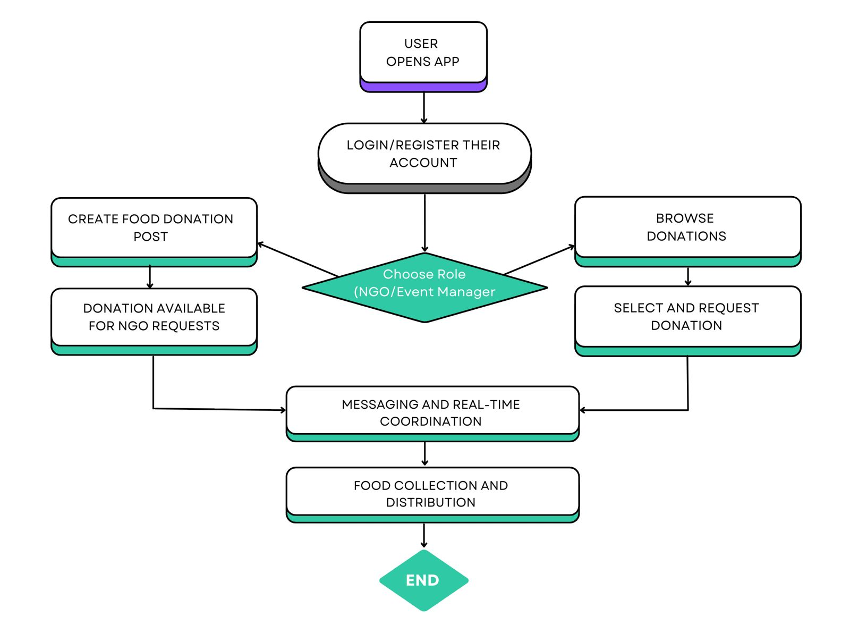

Slide 8
Technology Stack
Frontend Development
Framework: Flutter (Dart)
UI Components: FIGMA
State Management: Built-in StatefulWidget (basic level)
Navigation: Flutter Navigator
Backend Services
Database: Firebase Firestore (NoSQL)
Authentication: Firebase Authentication
Real-time Updates: Firestore Real-time Listeners
Cloud Functions: Firebase Cloud Functions
Maps & Location
Map Integration: google_flutter_map package
Location Services: geolocator package
Map Data: Google Map API
Coordinates: latlong2 package
Development Tools
Notes:
8

Slide 9
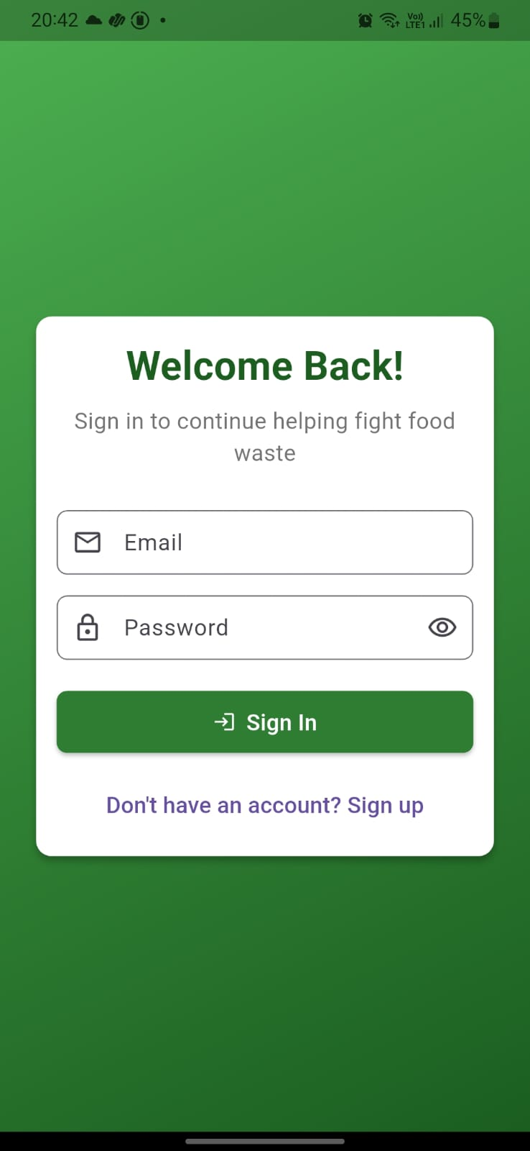
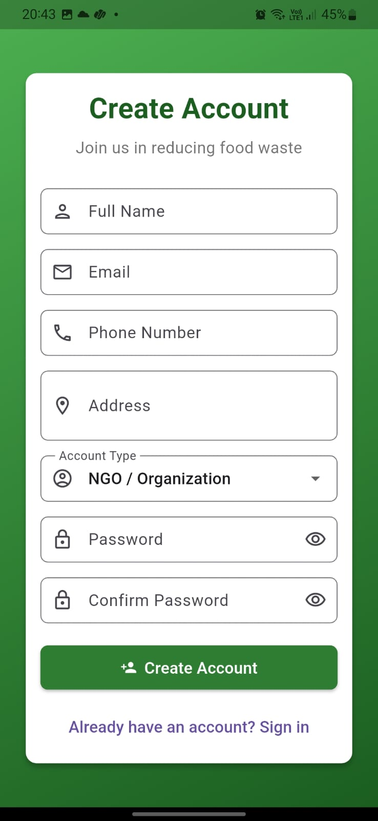
Implementation

Slide 10
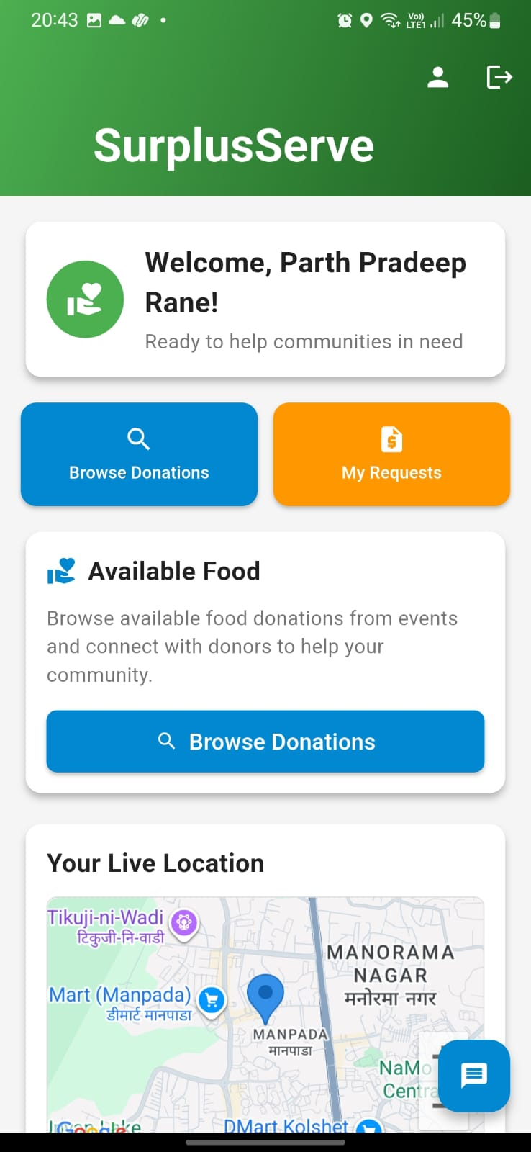
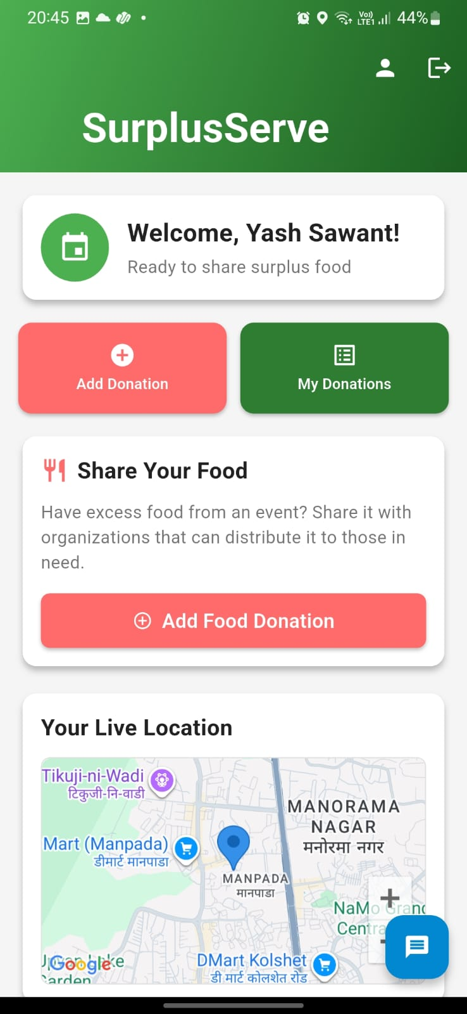

Slide 11
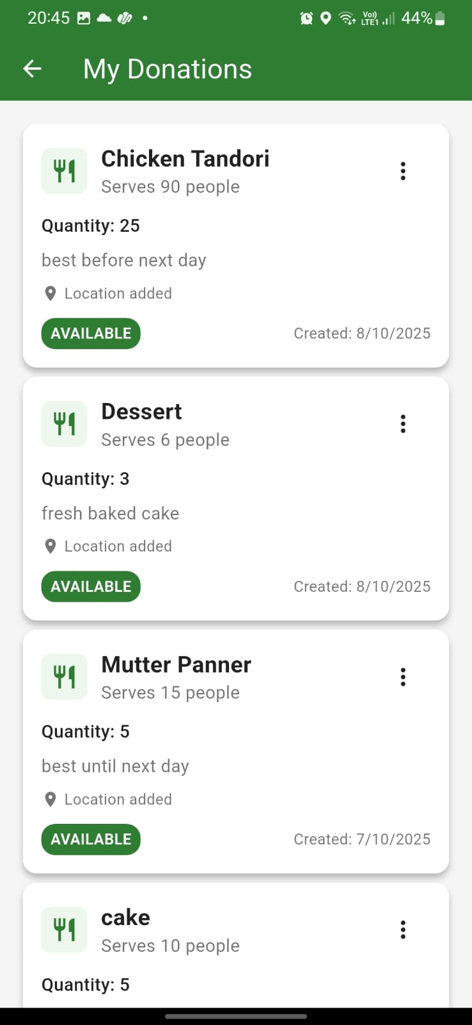
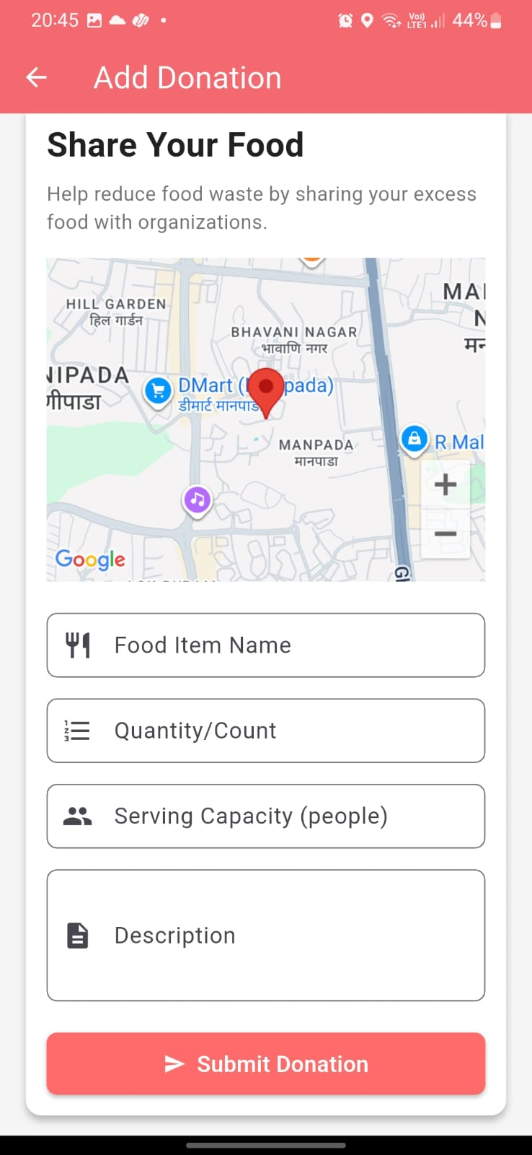

Slide 12
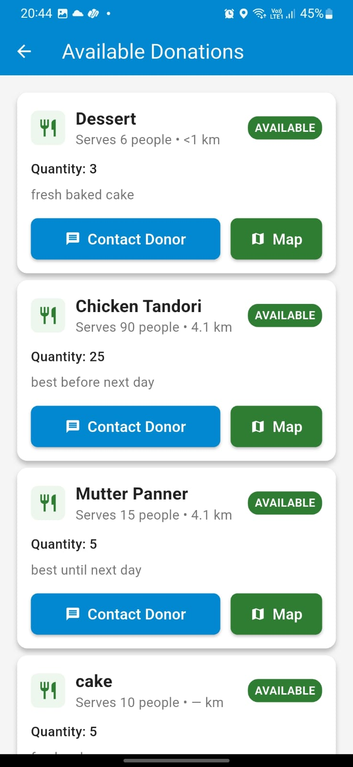
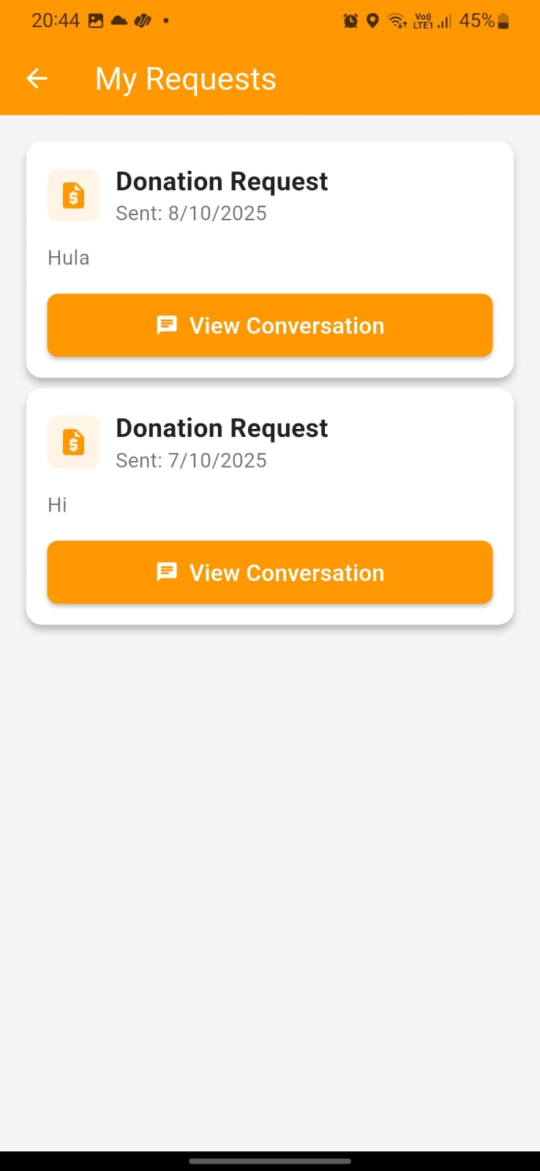

Slide 13
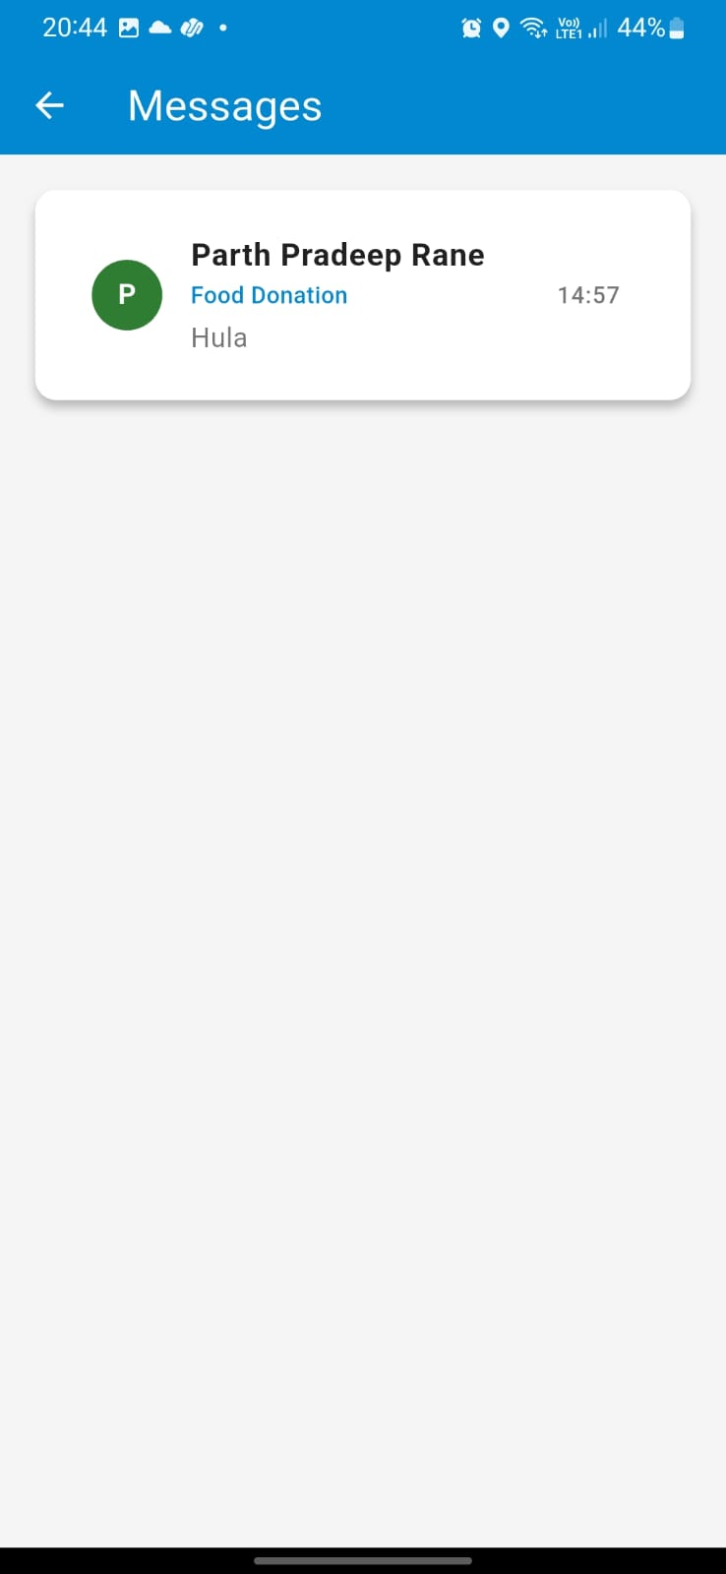
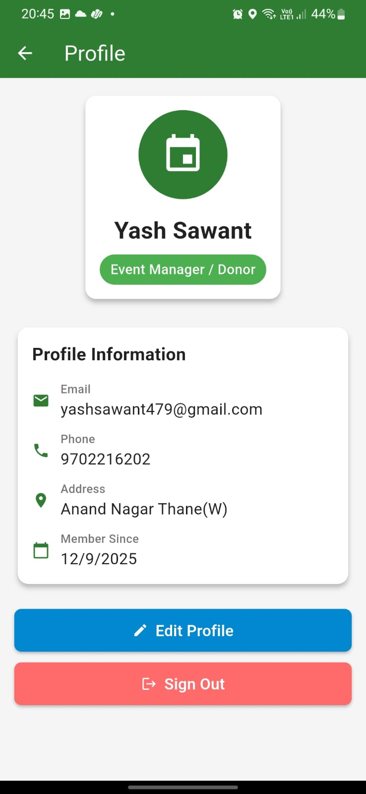

Slide 14
Mapped Sustainable Development Goals (SDGs)
SDG No. | Goal | How the App Contributes
2 | Zero Hunger | Helps feed underprivileged communities by redistributing edible surplus food effectively.
3 | Good Health and Well-being | Reduces hunger-related health issues through timely delivery of nutritious food.
12 | Responsible Consumption and Production | Minimizes food wastage by promoting sustainable consumption and efficient redistribution.
11 | Sustainable Cities and Communities | Encourages community engagement and local partnerships to solve social issues like hunger.
17 | Partnerships for the Goals | Builds networks between donors, NGOs, and volunteers to achieve shared humanitarian goals.
13 | Climate Action | Indirectly helps by reducing methane emissions from decomposing food waste.

Slide 15
Conclusion
The proposed app offers a practical solution to bridge the gap between surplus food donors and NGOs, reducing food waste and supporting hunger relief. Unlike existing systems, it focuses specifically on event-based surplus food, with real-time NGO notifications, geolocation-based matching, and verified pickups. The system contributes to Sustainable Development Goals (SDG 2 & 12) by promoting Zero Hunger and Responsible Consumption. With further development, this platform can scale across cities and integrate with local government and food safety authorities. Beyond technology, this project carries strong ethical, social, and humanitarian value making real impact with smart innovation.
Notes:
15

Slide 16
Reference
https://ijrpr.com/uploads/V6ISSUE4/IJRPR41332.pdf
"Helping Hand" is an Android-based application designed to streamline donations of food, clothing, and other essentials. It connects donors with NGOs and beneficiaries through a mobile-friendly platform that tracks donations, manages inventory, and ensures efficient distribution.
https://ijrpr.com/uploads/V5ISSUE4/IJRPR26147.pdf
. Food bridge acts as an avenue for socializing, teaching as well as sharing meals with others thus creating fairness and strength in feeding systems that can withstand any calamity.
https://ijrpr.com/uploads/V4ISSUE5/IJRPR13426.pdf
The Aahar app offers a range of features designed to make food donation easy and accessible. One of the key features of the app is the ability for donors to easily create a profile and list the type of food they have available for donation. The app also allows donors to set their location and availability, making it easy for receivers to find them.
Notes:
16

Slide 17
https://www.ijraset.com/research-paper/waste-food-management-and-donation-app
The idea behind over project can be use by many people who wish to donate things to needy organizations Also, many organizations like to ask for various things required by them such as clothes, food grains, books utensils.
https://claude.ai/chat/b25171fd-23b3-4d13-8b6c-7dc9d1b6c90b
Ai tool used for the project

Slide 18
Thank You...!!
Notes:
18

